Slide 1


G.H RAISONI COLLEGE OF ENGINEERING AND MANAGEMENT
LIFE EXPECTANCY USING POWER BI
Mentored By:-Mrs.Nutan Raut
07-Ashish Meshram
09-Ehzam Ali Khan
10-Himanshu Dhabe
15–Roshan Singh

Slide 2
Inspiration of Dataset
The data-set aims to answer the following key questions:
Does various predicting factors which has been chosen initially really affect the Life expectancy? What are the predicting variables actually affecting the life expectancy?
What is the impact of schooling on the lifespan of humans?
How does Infant and Adult mortality rates affect life expectancy?

Slide 3
Should a country having a lower life expectancy value(<65) increase its healthcare expenditure in order to improve its average lifespan?
Does Life Expectancy have positive or negative relationship with drinking alcohol?
Do densely populated countries tend to have lower life expectancy?
What is the impact of Immunization coverage on life Expectancy?

Slide 4

Acknowledgements
List of University Services
The data was collected from WHO and United Nations website with the help of Deeksha Russell and Duan Wang.

Slide 5

CONTEXT
Although there have been lot of studies undertaken in the past on factors affecting life expectancy considering demographic variables, income composition and mortality rates. It was found that affect of immunization and human development index was not taken into account in the past.

Slide 6
Important immunization like Hepatitis B, Polio and Diphtheria will also be considered. In a nutshell, this study will focus on immunization factors, mortality factors, economic factors, social factors and other health related factors as well. Since the observations this dataset are based on different countries, it will be easier for a country to determine the predicting factor which is contributing to lower value of life expectancy. This will help in suggesting a country which area should be given importance in order to efficiently improve the life expectancy of its population.

Slide 7


SOFTWARE/TOOLS USED :

Slide 8
CONTENT
The project relies on accuracy of data. The Global Health Observatory (GHO) data repository under World Health Organization (WHO) keeps track of the health status as well as many other related factors for all countries The data-sets are made available to public for the purpose of health data analysis. The data-set related to life expectancy, health factors for 193 countries has been collected from the same WHO data repository website and its corresponding economic data was collected from United Nation website. Among all categories of health-related factors only those critical factors were chosen which are more representative.

Slide 9
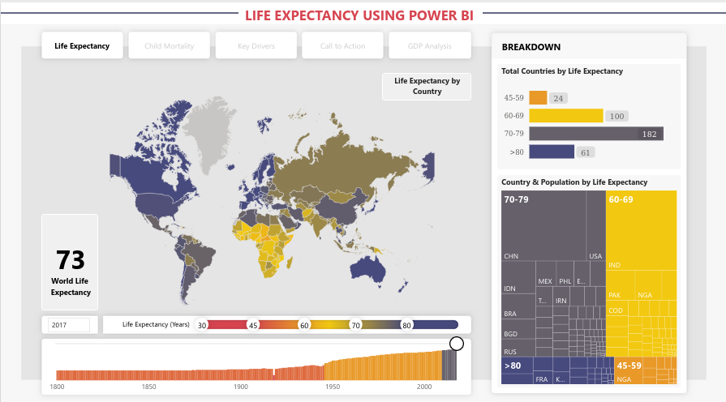
RESULT

Slide 10
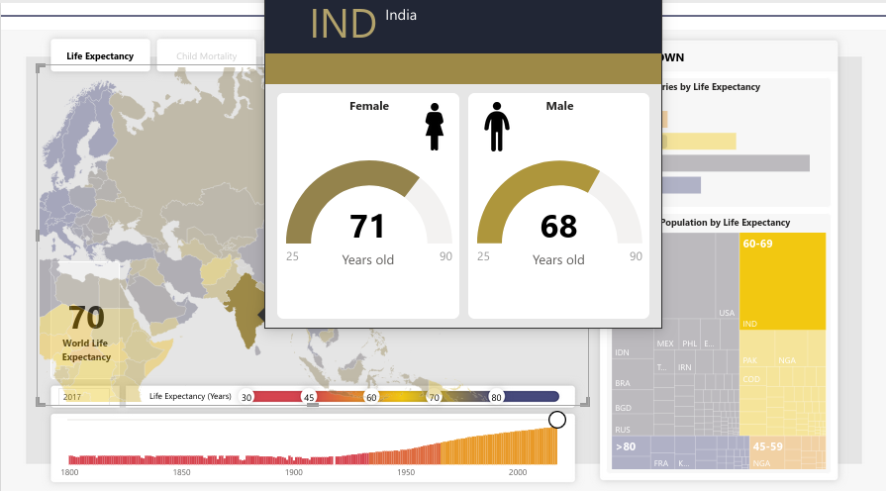

Slide 11
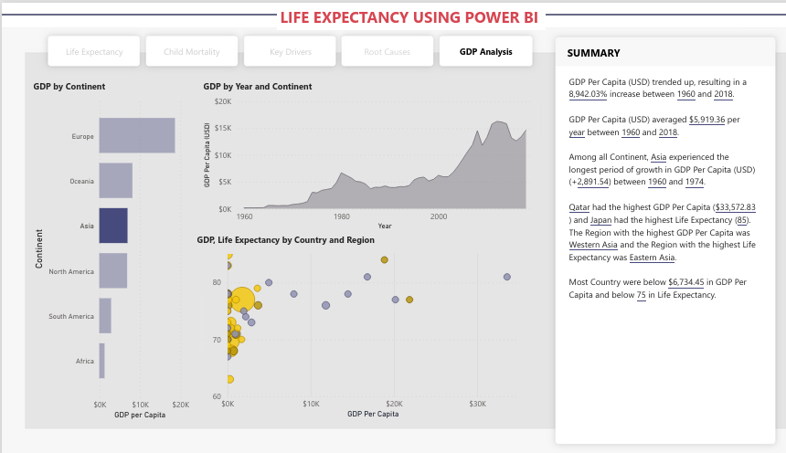

Slide 12
CONCLUSION
Power BI is one of the most powerful business intelligence tools for analyzing and visualizing data. Throughout this project, we discussed what Power BI is, why it is important, and the Power BI project ideas that we have implemeAnted to improve our data analysis and visualization skills. Power BI project examples generally aid companies in gaining actionable insights from better visualization of their data. Using Power BI, users can create interactive dashboards and share them across the internet

